Slide 1
Auth0 Online Meetup SAML 2.0
Rory Braybrook
Microsoft Identity Architect
@rbrayb
Feel free to ping me – especially if in Oceania ☺

Slide 2

Long Bay, Auckland

Slide 3
Overview
History
Protocols / Bindings / Profiles
SAML 2.0 stacks
Metadata
NameID
Demo. – SP Initiated to Auth0
SAML 2.0 packets and decoding the payload
IDP Initiated
Troubleshooting SAML 2.0
References

Slide 4
History
Collaboration between OASIS Security Services Technical Committee and the Liberty Alliance resulted in the SAML V2.0 specification being released in March 2005
By January 2008, deployments of SAML V2.0 became common in government, higher education, and commercial enterprises worldwide
Microsoft and IBM developed WS-Federation (WS-*). Used for SharePoint, CRM Dynamics, Office 365, ADFS etc. (Moving to “Modern Auth”)
Java and open source world went with SAML
Shibboleth, a free and open source SAML IDP built on OpenSAML and used extensively by academia
“Not suited” for mobile applications – browser redirects vs. REST, XML vs. JSON, much larger and more complicated payload. OpenID Connect / OAuth “better” choice
Still used extensively for enterprise federation
OpenID Connect Federation 1.0 - draft

Slide 5
Protocols / Bindings / Profiles
Assertions = claims
Protocols: how certain SAML elements (including assertions) are packaged within SAML request and response elements, and gives the processing rules that SAML entities like an IDP must follow when producing or consuming these elements
Bindings: determines how SAML requests and responses map onto standard messaging or communications protocols
Profiles: a concrete manifestation of a defined use case or the “How-to” using a particular combination of assertions, protocols, and bindings

Slide 6
Bindings
HTTP Redirect (GET) binding
HTTP POST binding
HTTP Artifact binding

Slide 7
Profiles
Web Browser SSO profile
Artifact Resolution profile
Enhanced Client or Proxy (ECP) profile
Single Logout Profile

Slide 8
Identity provider (IDP) / Service Provider (SP)
Application (SP) → SAML 2.0 → IDP (e.g. Auth0, ADFS, Azure AD, identityserver)
Application (SP) → Auth0 (IDP) → Auth0 (SP) → SAML 2.0 → Other IDP
R-STS – an IDP acting as a SP i.e. pass-through to another IDP for authentication

Slide 9
Metadata
Preferred way to provide endpoints, certificates etc. to the other party
XML structure – can be signed
<IDPSSODescriptor … />
<SPSSODescriptor … />
Auth0 example
ADFS example

Slide 10
NameID
The “primary key”
<NameIDFormat>urn:oasis:names:tc:SAML:1.1:nameid-format:emailAddress</NameIDFormat>
<NameIDFormat>urn:oasis:names:tc:SAML:2.0:nameid-format:persistent</NameIDFormat>
<NameIDFormat>urn:oasis:names:tc:SAML:2.0:nameid-format:transient</NameIDFormat>

Slide 11
SAML 2.0 stacks
Refer to blog post
From Microsoft .NET C# perspective
ComponentSpace (IDP / SP) .NET & .NET Core
Rock Solid Knowledge (IDP / SP) .NET Core
Sustainsys (SP) .NET & .NET Core
All can be used with identityserver 4

Slide 12
Demo. – SP Initiated to Auth0 via Sustainsys
The “Connecting series” – see blog post

Slide 13
SAML 2.0 packets and decoding the payload
Fiddler – “Text wizard”
samltool.io(Auth0 - online)
ADFS Help (Microsoft - online)
Firefox SAML tracer
SAML Chrome Panel
Feide online tool
How to View a SAML Response in Your Browser for Troubleshooting

Slide 14
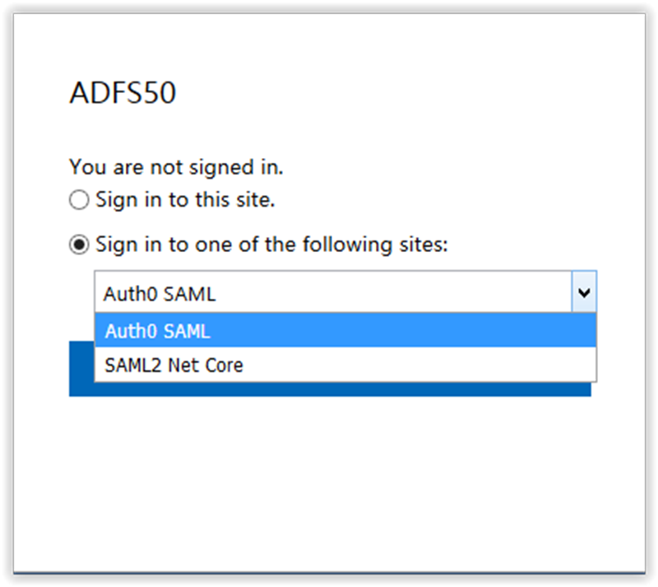
IDP Initiated – ADFS

Slide 15
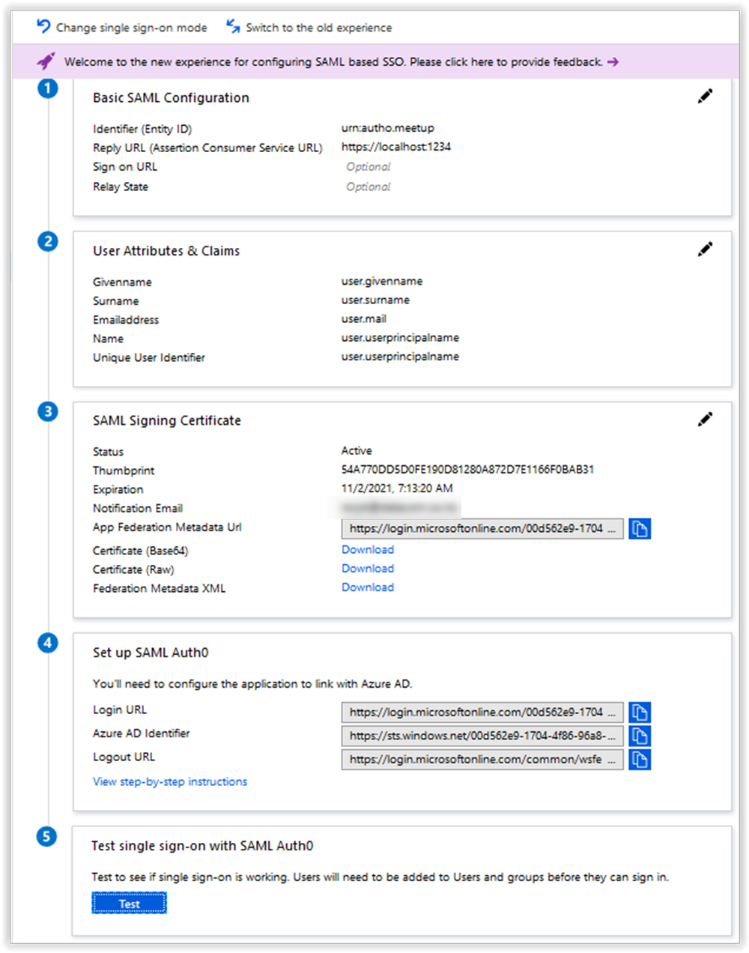
SAML 2.0 – Azure AD

Slide 16
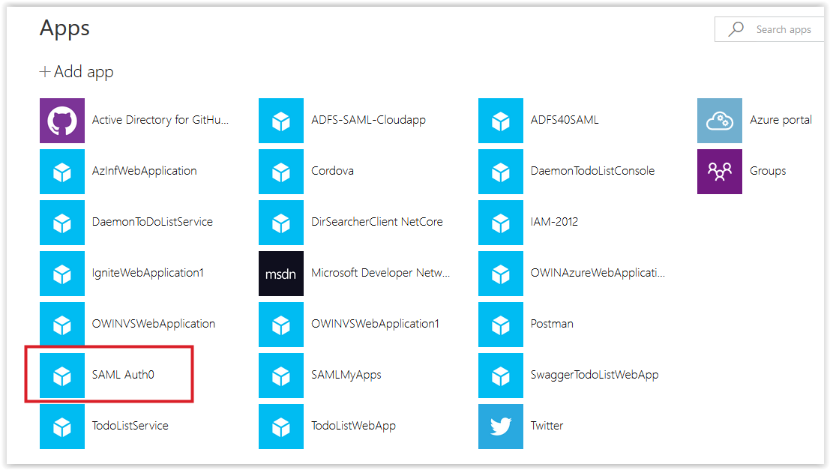
myapps.microsoft.com

Slide 17
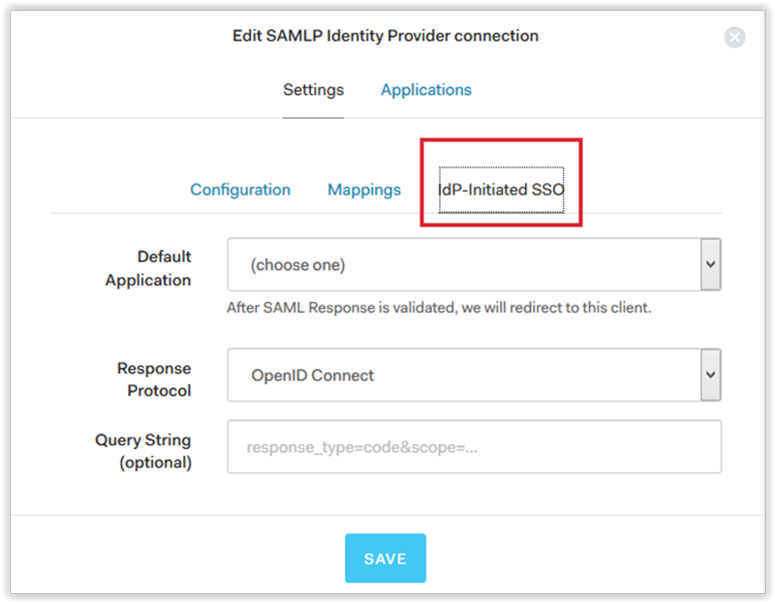
Auth0 IDPInitiated
Enterprise Connections / SAMLP Provider

Slide 18
“Bridging” incompatible SAML implementations
Client (SP) sends encrypted tokens
IDP does not support this
Problem!
Use ADFS / Auth0 etc. as a bridge (R-STS model)
From SP: configured for encryption
To IDP: no encryption
R-STS receives encrypted tokens and sends them in the clear

Slide 19
Troubleshooting SAML 2.0
Status = Responder!
Certificates – trusted, still valid, exchanged
NameID – correct type and format
Required assertions passed
SHA-1 / SHA-256
Signatures – online tool – SAML stack utilities

Slide 20
Number one stackoverflow question
How do I call a REST web API from a legacy SAML application?
Need to be able to convert SAML XML token to a JWT
SAML 2.0 Bearer Assertion Flow for OAuth 2.0

Slide 21
References – SAML 2.0 (OASIS)
Assertions and Protocols for the OASIS Security Assertion Markup Language (SAML) V2.0 (SAMLCore), the core specification
Bindings for the OASIS Security Assertion Markup Language (SAML) V2.0 (SAMLBind), which maps the SAML messages onto the standard messaging or communication protocols
Profiles for the OASIS Security Assertion Markup Language (SAML) V2.0 (SAMLProf), the use cases or the “How-to” in regards to the use of SAML in various situations
Specifying a technical profile for a SAML 2.0 claims provider
Wikipedia SAML
How to Study and Learn SAML

Slide 22
References
The new control plane
I need a SAML stack – now!
SAML stacks — the next step — the “Connecting” series
Connecting Auth0 (IDP) and the Sustainsys SAML v2.0 for .NET Core stack
Comparing the Identity Providers (IDP’s) that I use

Slide 23

Questions?

